Slide 1
DevSecOps Project
Secure Programming 2025

Slide 2
What
Secure DevOps for OWASP Vulnerable Python app
CI Pipeline with security checks
SAST Scan
Building and Scanning images
Tools:
GitHub Actions
Bandit Scan
Docker Scout

Slide 3
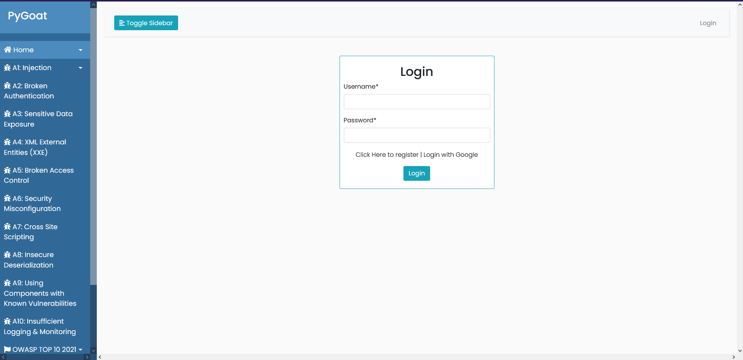

Slide 4
Github Actions
The vulnerable Python web application is open-source repository in GitHub
The DevSecOps is implemented on top of that with GitHub Actions
GitHub Actions is used for automation of the code:
Implemented the workflows in to the workflows/main.yml
The test are automately ran everytime after the commit

Slide 5
SAST with Bandit
The application layer has security vulnerabilities which can allow hackers to hack into system.
Vulnerabilities such as: hardcoded secrets, command/shell injections, weak hashing algorithms etc.
Bandit is a tool to find common security issues in Python code.
This is used to run static application security tests (SAST) on the app.

Slide 6
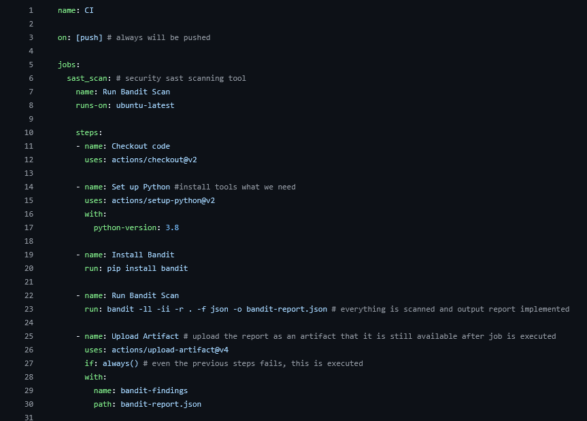
.

Slide 7
Container image scanning with Docker Scout
Since the system is produced with Docker images as application artifacts, container images will be scanned.
Test how secure Docker images are
Before scanning the images need to be built
Dockerfile creates images and multiple layers, which can contain security vulnerabilities.
Dependencies and libraries with vulnerabilities
Operating system packages and software with vulnerabilities

Slide 8
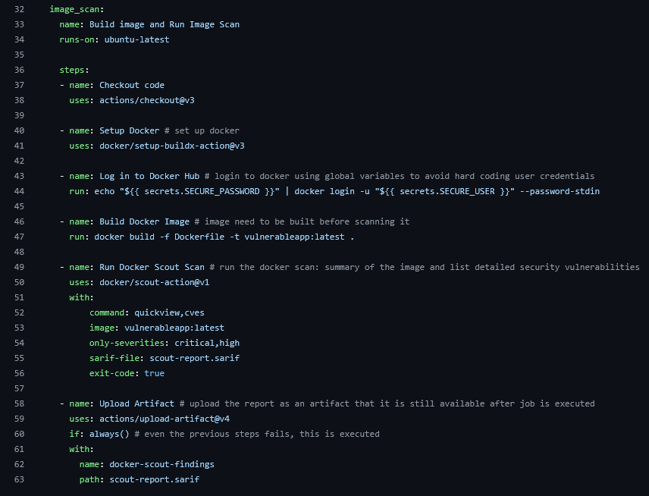

Slide 9
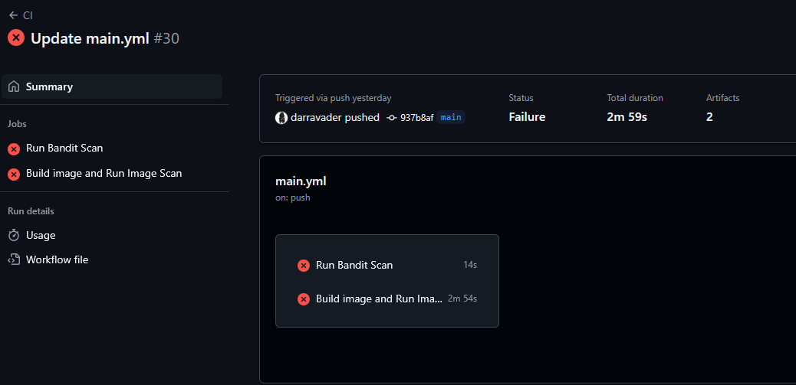
Workflow results
As expected, the Github Actions fails
It fails due to the vulnerability issues

Slide 10
Bandit Scan Results
Json file is saved as an artifact
Filtered severities: High and Critical
Total Issues: 2
High Confidence Issues: 2
Severity Levels:
High: 2

Slide 11
Key Issues in Bandit Scan
Risky Subprocess Call:
File: ./introduction/mitre.py
Line: 230
Severity: High
Problem: Code uses subprocess.Popen with shell=True, which can lead to shell injection vulnerabilities.
Solution: Avoid using shell=True and use safer methods to run commands.
Risky Subprocess Call:
File: ./introduction/views.py
Line: 423
Severity: High
Problem: Another instance of subprocess.Popen with shell=True. This also poses a shell injection risk.
Solution: Avoid using shell=True and use safer methods to run commands.

Slide 12
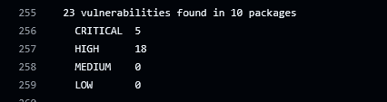
Image Scanning Results
Due to many errors, I decided to edit the job to filter only critical issues to keep this simple:

Slide 13
Image Scanning Results with only critical severity
Total of 627 packages 5 packages are critical vulnerable.
PyYAML 5.1:
Problem: Can run dangerous code hidden in YAML files.
Solution: Update to version 5.4 or later.
Django 4.1.7:
Problem: Can bypass validation when uploading multiple files.
Solution: Update to version 4.1.9 or later.
Pillow 9.4.0:
Problem: Can execute arbitrary code via the environment parameter.
Solution: Update to version 10.2.0 or later.

Slide 14
Use of AI
Help to analyze the scan results
Fixing the workflow script

Slide 15
Next steps?
Fixing the issues
New scans and analyzes

